Slide 1
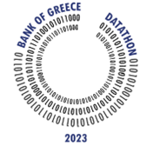
Idea Presentation
Datathon 2023
Bank of Greece
Team ML’s (Machine Learner’s)
Isaak Karagiannidis
MSc Data Science
Dimitris Alexiou
MSc Information and Communication Systems Engineering

Slide 2
Idea
The app uses machine learning algorithms and open source tools, in order to predict the real estate price index by geographic area in the wider area of Greece, but also a calculator to calculate mortgage installments.

Slide 3
Value Proposition
Our property value predictor tools use machine learning algorithms to make predictions based on various data points, providing valuable insights for investors and real estate agents.

Slide 4
Revenue model
The app can be offered for a subscription-based model that includes additional features or benefits.

Slide 5
Target Group
Target Group
Investors who want to predict real estate property values.
Key Partners
Real estate agents and mortgage brokers who can help promote the app to their clients.
Financial institutions who may want to offer the app to their customers.

Slide 6
Open Data Streams
The Open Data are gathered from the Bank of Greece, European Central Bank and the Bank for International Settlements.

Slide 7
Problems faced/resolved
The volume of data provided by the Bank of Greece is not sufficient for proper training of the algorithms, although we can gather additional data from European Central Bank and the Bank for International Settlements for the first sprint.

Slide 8
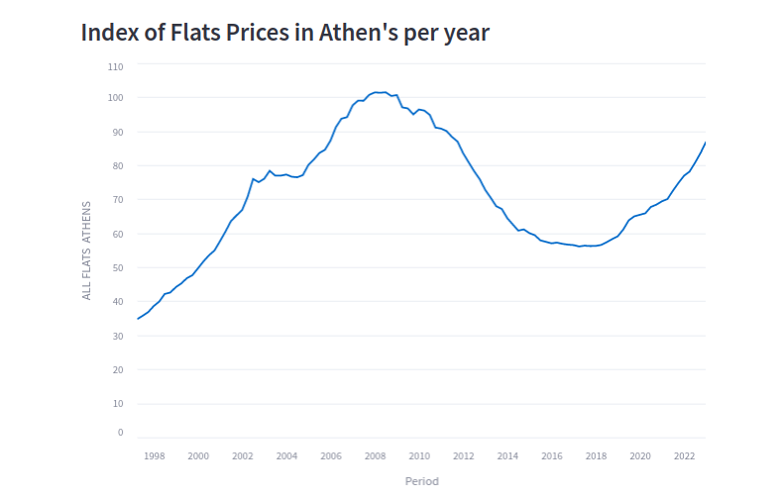
Visualizations

Slide 9
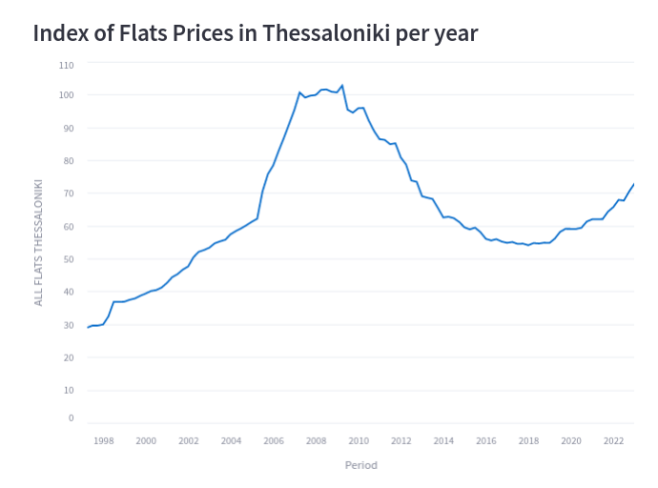
Visualizations

Slide 10
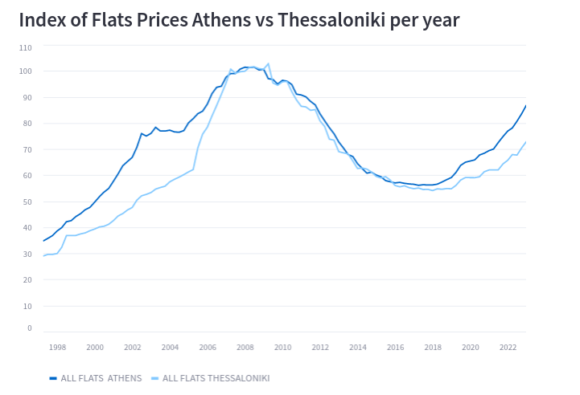
Visualizations

Slide 11
Architecture
First draft of the architecture for the machine learning algorithm uses the programming language Python and the following libraries:
Pandas
NumPy
Matplotlib-Seaborn
Scikit-Learn
Pickle
As for the rest of the architecture model, the UI part can be developed using the React framework coordinated by an Express Node server, aiming the app for Web use, although the complete architecture is to be discussed and decided in a later sprint.

Slide 12
First small UI Drafts

Slide 13
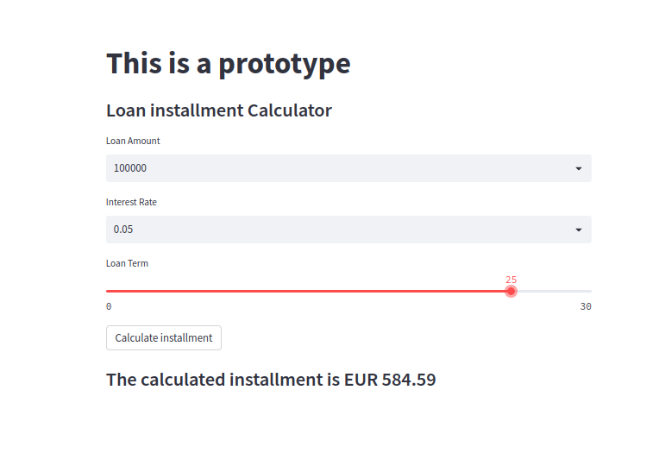
First small UI Drafts

Slide 14
First small UI Drafts

Slide 15
Thank you for your time
Team ML’s (Machine Learner’s)
Isaak Karagiannidis
MSc Data Science
Dimitris Alexiou
MSc Information and Communication Systems Engineering

